Slide 1
Medical Ethics

Slide 2
Contents
Definition
Why ethics is important ?
Milestones of medical ethics
Principles of medical ethics
Physician-patient relationship
Physician-society relationship
Physician-colleagues relationship
Ethical issues in medical research
References

Slide 3
Definition
Ethics: Moral principles that govern a person’s behaviour or the conducting of an activity.
Medical Ethics: System of moral principles that apply values and judgements to the practice of medicine

Slide 4
Link between medical ethics, law, profession and human rights
Medical Profession
Medical Ethics
Law
Human Rights

Slide 5
Why ethics is important ?
Conflicts of interest
Govt Vs Medical Institutions
Medical Institutions Vs Medical persons
Physicians Vs Patients
are getting serious and complex
High technology- brought us hopes of cure but also created heavy economic burden
Brain death, organ transplantation and concerns over quality of life—Ethical dilemma.

Slide 6
Ethics Vs Morality
Ethics
Morality
Rules of conduct recognised in respect to a particular class of human actions/ a particular group.
Social system—External
We do it because the society says it is the right thing to do.
Principles/ habits with respect to right/ wrong conduct
Individual—Internal
We do it because we believe in something right/ wrong

Slide 7
Ethics Vs Morality
Ethics
Morality
Face peer pressure/ societal disapproval/ firing from job
Governed by professional and legal guidelines.
Feel uncomfortable, remorse, depressed etc.
Morality transcends cultural norms.

Slide 8
Ethics Vs Laws
Ethics are rules of conduct.
Ethics comes from people’s awareness of what is right and wrong.
Laws are rules developed by governments in order to provide balance in society and protection to its citizens.
Laws are enforced by governments to its people.

Slide 9
Ethics Vs Laws
Ethics are moral codes which every person must conform to.
Ethics does not carry any punishment to anyone who violates it.
Ethics comes from within a person’s moral values.
Laws are codifications of ethics meant to regulate society.
The law will punish anyone who happens to violate it.
Laws are made with ethics as a guiding principle.

Slide 10
First step in the evolution of ethics is a sense of solidarity with other human beings—Albert Sweiter

Slide 11
Milestones in evolution of ethics
1947— Nuremberg Code, Formation of World Medical Association
1948—Universal declaration of Human Rights, Declaration of Geneva (revised till 2006)
1949—International Code of Medical Ethics(1968, 1983 and 2006)
1964—Declaration of Helsinki(2004 revised)
1974—National research Act and IRB System
1979— The Belmont Report

Slide 12
1982—International Guidelines for Biomedical Research involving human subjects
1991—International guidelines fro ethical review in Epidemiological studies
1997—Universal declaration on Human Genome and Human Rights
2003—International Declaration of Human gene data
2005—Universal Declaration on Bioethics and Human Rights

Slide 13
Nuremberg Code(voluntariness of consent)
Informed consent is essential
Research should be based on prior animal work
The risks should be justified by anticipated benefits
Only qualified scientists must conduct research
Physical and mental suffering must be avoided
Research in which death/ disability injury is expected should not be conducted

Slide 14
Belmont report
The public health service syphilis study 1932-1971
Cases and controls were selected
Were deliberately misinformed about the procedures
Spinal taps were described necessary and special free treatment
1940’s penicillin was found to be safe and effective for syphilis but these people were denied for that
Resulting in deaths and disabilities
National commission was set up and Belmont report was published

Slide 15
Principles of Medical Ethics
Autonomy
Beneficence
Justice
Non malfeasance (Do no harm)

Slide 16
Autonomy(Informed consent and Privacy)
Freedom to influence course of life or treatment
Elements of autonomy include
Mental capacity, the ability to understand and process information
Voluntariness, freedom from the control/influence of others

Slide 17
Beneficence
Minimise harms and maximise benefits
Requirement to use the best possible research design to maximise benefits and minimize harms
Prohibition of research that is without a favourable risk-benefit ratio

Slide 18
Justice
Requires us to treat people fairly and to design research so that burdens and benefits are shared equitably
Requirement to avoid exploitation of vulnerable population

Slide 19
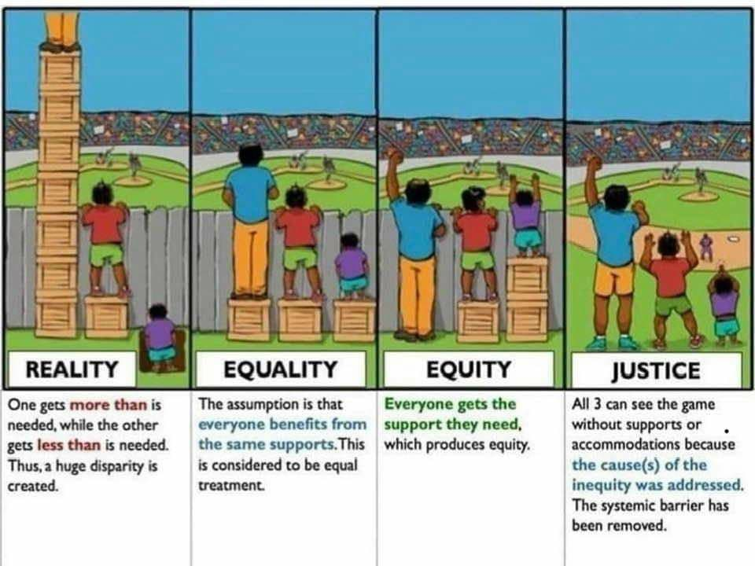

Slide 20
World Medical Association and its role
1947—year in which it was found.
International organisation
Consultation of draft statements—Careful consideration of comments of WMA ethics Committee—Specially appointed groups for re drafting and further consultation—Annual Assembly
>75% vote in favour of any new/revised Policy
Process—Can be lengthy.

Slide 21
Approach to ethical issues at individual level
Non-Rational
Rational
Obedience
Imitation
Feeling/ desire
Intuition
Habit
Deontology
Consequentialism
Principlism
Virtue ethics
Notes:
Obedience---common way of making ethical decisions esp in those who work in authoratative structures like militatry, police, some religious organisation etc. whether agree o not agree u follow it
Imitation– subordinates– one’s judgement– role model like a teachers and seniorvconsultants
Feeling/desire– subjective approach moral deceision making and behaviour--– measure of moraity
Intuition- an immediate perception of the right way to act in the situation--entirely subjective
Habit- very efficient method of decesion making no need to repeat a syst deceision making process

Slide 22
Deonatology
A search for well founded rules that serve as the basis for making moral decisions
Foundation can be religious/ non religious
Once rules established—Have to be applied in specific situations
Often there is a room for disagreement about what the rules are required

Slide 23
Consequentialism
Ethical decision making on an analysis of the likely consequences/ outcomes of diff choices and actions
Right actions– produces best outcomes
Do not have much principles
Too difficult to identify, prioritise and apply
Greatest good for the greatest number
End justifies the means

Slide 24
Principlism
Uses ethical principles– basis for moral decision
Applies to particular cases– what to do– right thing
Present ethics is based of four basic principles

Slide 25
Virtue ethics
Virtue is type of moral excellence
Focuses less on decision making and more on character of decision making as reflected by their behaviours
Honesty, compassion, prudence and dedication

Slide 26
Physician-patient relationship
Respect and equal treatment
Communication and consent
Decision making for incompetent patients
Confidentiality
Beginning of life issues
End of life issues
Notes:
Respect and equal treament– unequality issues– slavery, non whites, women discrimination based of age disbilty sexual oriettation
2 apposed ideologies– chriatian faith– amercian revulation and anti chrisian faith– french revolution took place—
Presently democratic concept after universal declaration of human rights 1948– patient’s rights– patients sfety issues are rising
Communication and consent– informed consent forms the central concept– good communication between the physician and patient barriers—language and culture difference
2 types of consent– explicit(orally o in writing) and implicit(implied) like venepuncture giving hand
Incompetatnt indviduals—young patients, psychiatric patients and neuro conditions/ temp comatose o uncounsious conditions
Advance directive concept
Confidentiality– autonomy respect for other and trust forms the main core of confidentiality– breeches only in some justified issues but to be kept to minimum—dsinated diseases, those deemed not to fit to drive and child abuse
Weight the choices when its in dilemma even in criminal cases consent becomes important
Beginnning of life issues– contraception, assisted reproduction prenatal genetic screening and abortion main issues
End of life issues– euthanaisa and assistance to suicide---debatable

Slide 27
Physician and the Society
Dual loyalty
Resource allocation
Public health
Global health
Notes:
Dual loyalty– have responsibility and are accountable answerabale to both authorities and patients and performs dual loyalty. Patient consent and confidentiality to be maintanined and appropriate authorirties to be informed. Conflict of interest– between pharma companies and patient’s treatment
Resource allocation at three levels
Macro level– government decides– overall budget to health
Meso level– hospital, clinics and health care agencies decide spend on staff, equipment etc
Micro level—individual level– investigations required, tests ordered, should be hospitalised o no.. Generic and ethical issues?
Public healh measures like vaccination, emergency responses to outbreaks of contiagious diseases
Interets of public conflict with those of individuals vaccination –AEFI dual loyality issues
Global health concerns like SARS, ebola, zika virus, swine flu etc
International mobility of health professionals including physicians

Slide 28
Physicians and colleagues
Relationship with physician colleagues, teachers and students
Reporting unsafe/ unethical practices
Relationship with other health professionals
Cooperation
Conflict resolution
Notes:
Hierical fashion internally and externally
Internally amoung the branches and their hierachy medicine better than patho, better than community medicine etc
Externally btw other health care professionals doctors are better from nurses, and other health care staff
Coopertaive model>> authorattive model
Declartion of geneva--- my collques are my brothers and siisters but proffessional courtesy is decresing these days.

Slide 29
Ethics in medical research

Slide 30
Introduction
Goal of clinical research—Generation of useful knowledge about human health and illness
Kantian ethics—We should treat people as ends, never as means/ subjects and never simply as objects

Slide 31
General guidelines as per ICMR
The purpose of such research is that it should be directed towards the increase of knowledge about the human condition and such research should be betterment of all
Conducted under the conditions that no person/s become mere means for betterment of others conducive to and consistent with their dignity and well being under professional fair treatment and transparency
Subjected to regime of evaluation at all stages of the proposal

Slide 32
General principles
Essentiality
Voluntariness, informed consent and community agreement
Non-exploitation
Privacy and confidentiality
Precaution and risk minimization
Professional competence

Slide 33
Contd..
Accountability and transparency
Maximisation of public interest and of distributive justice
Institutional arrangements
Public domain
Totality of responsibility
Compliance

Slide 34
Institutional ethics committee-Basic responsibilities
To protect the dignity, rights and well being of the potential research participants
To ensure that universal ethical values and international scientific standards are expressed in terms of local community values and customs
To assist in the development and the education of a research community responsive to local health care requirements

Slide 35
Composition
Independence and competence are two hallmarks of an IEC
8-12 members (fairly small)
Minimum of 5 persons form a quorum
Chairman—Outside the institution—To maintain the independence
Member secretary—Should be of same institution
Others members mixture of Medical/ Non-medical, Scientific and Non scientific persons

Slide 36
Contd…
Chairperson
One-two persons from basic medical area
One-two clinicians from various institutes
One legal expert/ retired judge
One social scientist/ representative of NGO
One philosopher/ ethicist/ Theologian
One lay person from the community
Member secretary

Slide 37
Concept of Minimum Risk
Defined as one which may be anticipated as harm/ discomfort not greater than encountered in routine daily life activities of general population/ during the performance of routine physical/ psychological examination/ tests

Slide 38
Review procedures—Scrutiny into 3 categories
Exemption from review: which present < than minimal risk ex: research for educational purposes
Expedited review: no more than minimum risk to research participants. Member secretary and chairperson of IEC/ designated member of Committee/ sub committee of IEC—May do this
Full review: > Minimum risk that involve vulnerable population and special groups by all members

Slide 39
INFORMED CONSENT PROCESS
Adequate information about the research is given in a simple and easily understandable unambiguous language in a document known as the Informed Consent Form with Participant/ Patient Information Sheet.

Slide 40
PATIENT INFORMATION SHEET
Nature and purpose of study stating it as research
Duration of participation with number of participants
Procedures to be followed
Investigations, if any, to be performed
Foreseeable risks and discomforts adequately described and whether project involves more than minimal risk
Benefits to participant, community or medical profession as may be applicable

Slide 41
Policy on compensation
Availability of medical treatment for such injuries or risk management
Alternative treatments if available
Steps taken for ensuring confidentiality
No loss of benefits on withdrawal
Benefit sharing in the event of commercialization
Contact details of PI or local PI/Co-PI in multicentre studies for asking more information related to the research or in case of injury

Slide 42
Contact details of Chairman of the IEC for appeal against violation of rights
Voluntary participation
If test for genetics and HIV is to be done, counseling for consent for testing must be given as per national guidelines
Storage period of biological sample and related data with choice offered to participant regarding future use of sample, refusal for storage and receipt of its results
Notes:
A copy of informed consent form to be given to the participants
Fresh/ re consent in case of
Availability of new information which would necessiate the deviation of protocol
Research participant regains counsiousness to better understand the study
Long term follow up in necessary
When there is change in modality of treatment o alternative treatments are available
waiver of consent in case of < minimal risk research, researcher do not come in contact with the patients and in case of emergencies

Slide 43
Some important issues
Conflict on interest
Selection of special groups as research participants—Pregnant women, children and vulnerable groups
Compensation for accidental injury
Post trial access
Researcher’s relations with the media and publication practices

Slide 44
References
Sravabutanam SS, Hridaya A. Medical ethics in india. 1988;2:145–9.
Medical Ethics Manual. 2015.
GUIDE TO PROFESSIONAL CONDUCT AND ETHICS. 2009;
World Medical Association International Code of Medical Ethics. 1983.
Jain A P, Manish Jain. FUNDAMENTAL ISSUES IN MEDICAL ETHICS. 2006.
J V Dixit. PRINCIPLES AND PRACTICE OF MEDICAL RESEARCH. 2015.

Slide 45
Ethical Principles for Medical Research Involving Human Subjects WMA Declaration of Helsinki Working Group. 2013.
ETHICAL GUIDELINES FOR ON HUMAN PARTICIPANTS INDIAN COUNCIL OF MEDICAL RESEARCH. 2006;
Guidelines for preparing Standard Operating Procedures ( SOP ) for Institutional Ethics Committee for Human Research.
The Nuremberg code. 1949.
The Belmont Report.
Universal Declaration of Human Rights.
Declaration of Geneva. 2006;

Slide 46


